Slide 1
TTIP as class war
Presentation by Paul Murphy to Desmond Greaves school 13 September 2015
ISDS, ‘The Lobby’ and our resistance -

Slide 2
Conspiracy or class?
TTIP not as conspiratorial exception, but the rule. In line with EU policy internally and externally.
Internal: ‘Austerity’ / Neo-liberalism, anti-democratic, environmentally unsustainable, imperialistic - Greece
External: Neo-liberalism, anti-democratic, environmentally unsustainable, imperialistic
Undermining of democratic rights is consistent and functional e.g. authoritarian neo-liberalism, TTIP

Slide 3
Trade as a weapon
Economic Partnership Agreements (EPAs), Deep and Comprehensive Free Trade Agreements (DCFTAs), European Neighbourhood Policy (ENP)
Driving deregulation of social, environmental, labour standards, undermining right to regulate into future and pushing privatisation
Circumventing and undermining democratic rights
Ensuring maintenance of LDCs as source of natural and human resources, but not rising up value chain

Slide 4
Who are the ‘partners’ in TTIP?
“TTIP is correctly understood not as a negotiation between two competing trading partners, but as an assault on European and US societies by transnational corporations seeking to remove regulatory barriers to their activities on both sides of the Atlantic.”
- John Hilary “The Transatlantic Trade and Investment Partnership: A Charter for Deregulation, an attack on jobs, an end to democracy”

Slide 5
A Free Trade Agreement?
Average tariffs for EU imports into US are 5.2%
Average tariffs for US imports into EU are 3.5%
80% of estimated ‘benefits’ come from so-called Non-Tariff Barriers (NTBs)
These NTBs include things that the rest of us refer to as environmental, labour, health, consumer, financial regulations

Slide 6
A ‘gold standard’ for the world
Transatlantic Trade and Investment Partnership (TTIP) - the world’s largest free trade area (750 million people).
With TransPacific Partnership (TPP), driving a global agenda – a ‘gold standard’ for the world.
Setting a high bar of liberalisation and enshrining corporate rights with ISDS and regulatory harmonisation.

Slide 7
Investor State Dispute Settlement
Corporations right to sue states in private tribunals – in reality, privileged access to private justice
Investors should be protected “against direct and indirect expropriation”, including the right to compensation
Parallel with Fiscal Treaty, 6-Pack, 2-Pack etc. within EU - policies become a matter of ‘law’ rather than politics – policy-space restricted

Slide 8
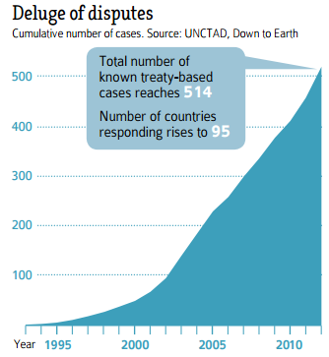
ISDS – the weapon of choice

Slide 9
We’re all expropriators now
“Measures tantamount to expropriation”, “indirect expropriation”, “regulatory expropriation”
”Because any new regulation is bound to have some economic impact on private assets, this doctrine is a formula to shrink the reach of modern government and cripple the regulatory state–undermining long-established protections for social welfare and economic justice, environmental values and individual rights.” - William Greider, “The Right and US Trade Law: Invalidating the 20th Century” (The Nation)

Slide 10
Some emblematic disputes
Philip Morris v. Uruguay and Australia – plain packaging.
Vattenfall v. Germany – seeking €3.7 billion in compensation for lost profits from phaseout of nuclear power.
Lone Pine v. Canada – seeking $250 million for moratorium on fracking in Quebec.

Slide 11
Some more…
Canada v. Abitibi Bowater – Settlement of $130 million and recognition of private ownership of natural resources.
Veolia v. Egypt – Raising the minimum wage
Ethyl Corporation v. Canada – Settlement of $13 million and withdrawal of ban on health hazard, petroleum additive MMT.

Slide 12
Chilling effect
“I’ve seen the letters from the New York and DC law firms coming up to the Canadian government on virtually every new environmental regulation […] Virtually all of the new initiatives were targeted and most of them never saw the light of day.”
- Former Canadian government official

Slide 13
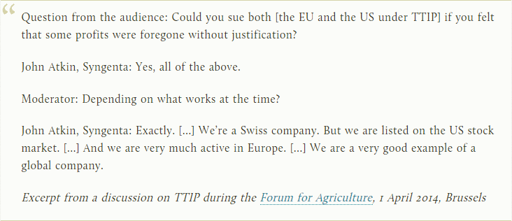
Transatlantic companies…

Slide 14
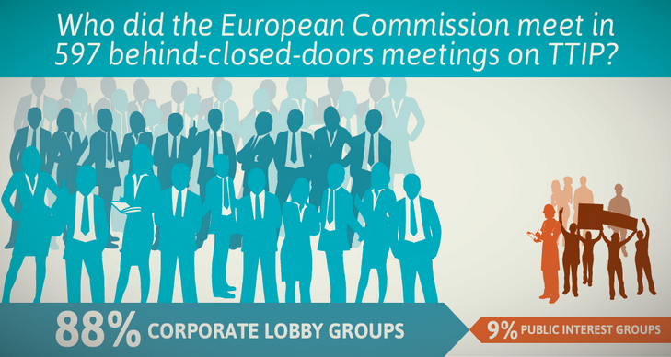
How their interests are conveyed (source: Corporate Europe Observatory)

Slide 15
Non-transparent lobbying

Slide 16
The revolving door

Slide 17
Undemocratic from start to finish
Negotiations conducted by Commission in secrecy
“The European Parliament shall be immediately and full informed at all stages of the procedure.” (Lisbon Art. 218.10)
That means seven MEPs seeing documents.
Privileged access of big business to negotiators.

Slide 18
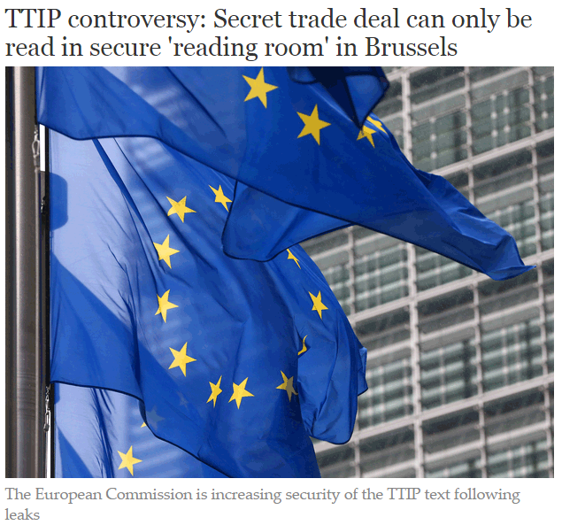
TTIP talks are “most open ever”

Slide 19
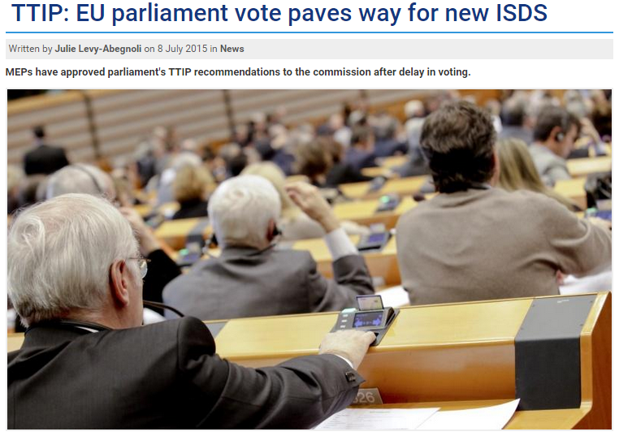
EU Parliament and ISDS

Slide 20
Our ‘representatives’

Slide 21
However… A winnable battle
Negotiations were supposed to be concluded by end 2014
ISDS negotiations weren’t re-opened until then
70,000 submissions received for ISDS public consultation

Slide 22
The institutional hurdles
Negotiations stage – 11th round October 19-23 in Miami
Qualified Majority Voting at Council
Majority in European Parliament – straight yes/no
Majority in all national parliaments if a ‘mixed agreement’ – this can change

Slide 23
The political hurdles… us
Lessons of the ACTA victory - the ‘dracula strategy’
Exploit contradictions between EU & US
Anti-TTIP groups established in most European countries, major issue in Germany, France, Belgium, growing issue in Ireland
Trade Unions and US action are crucial
Don’t forget about CETA
Integrate TTIP into our anti-austerity struggles as well as specific action

Slide 24
Next week of action

